Slide 1
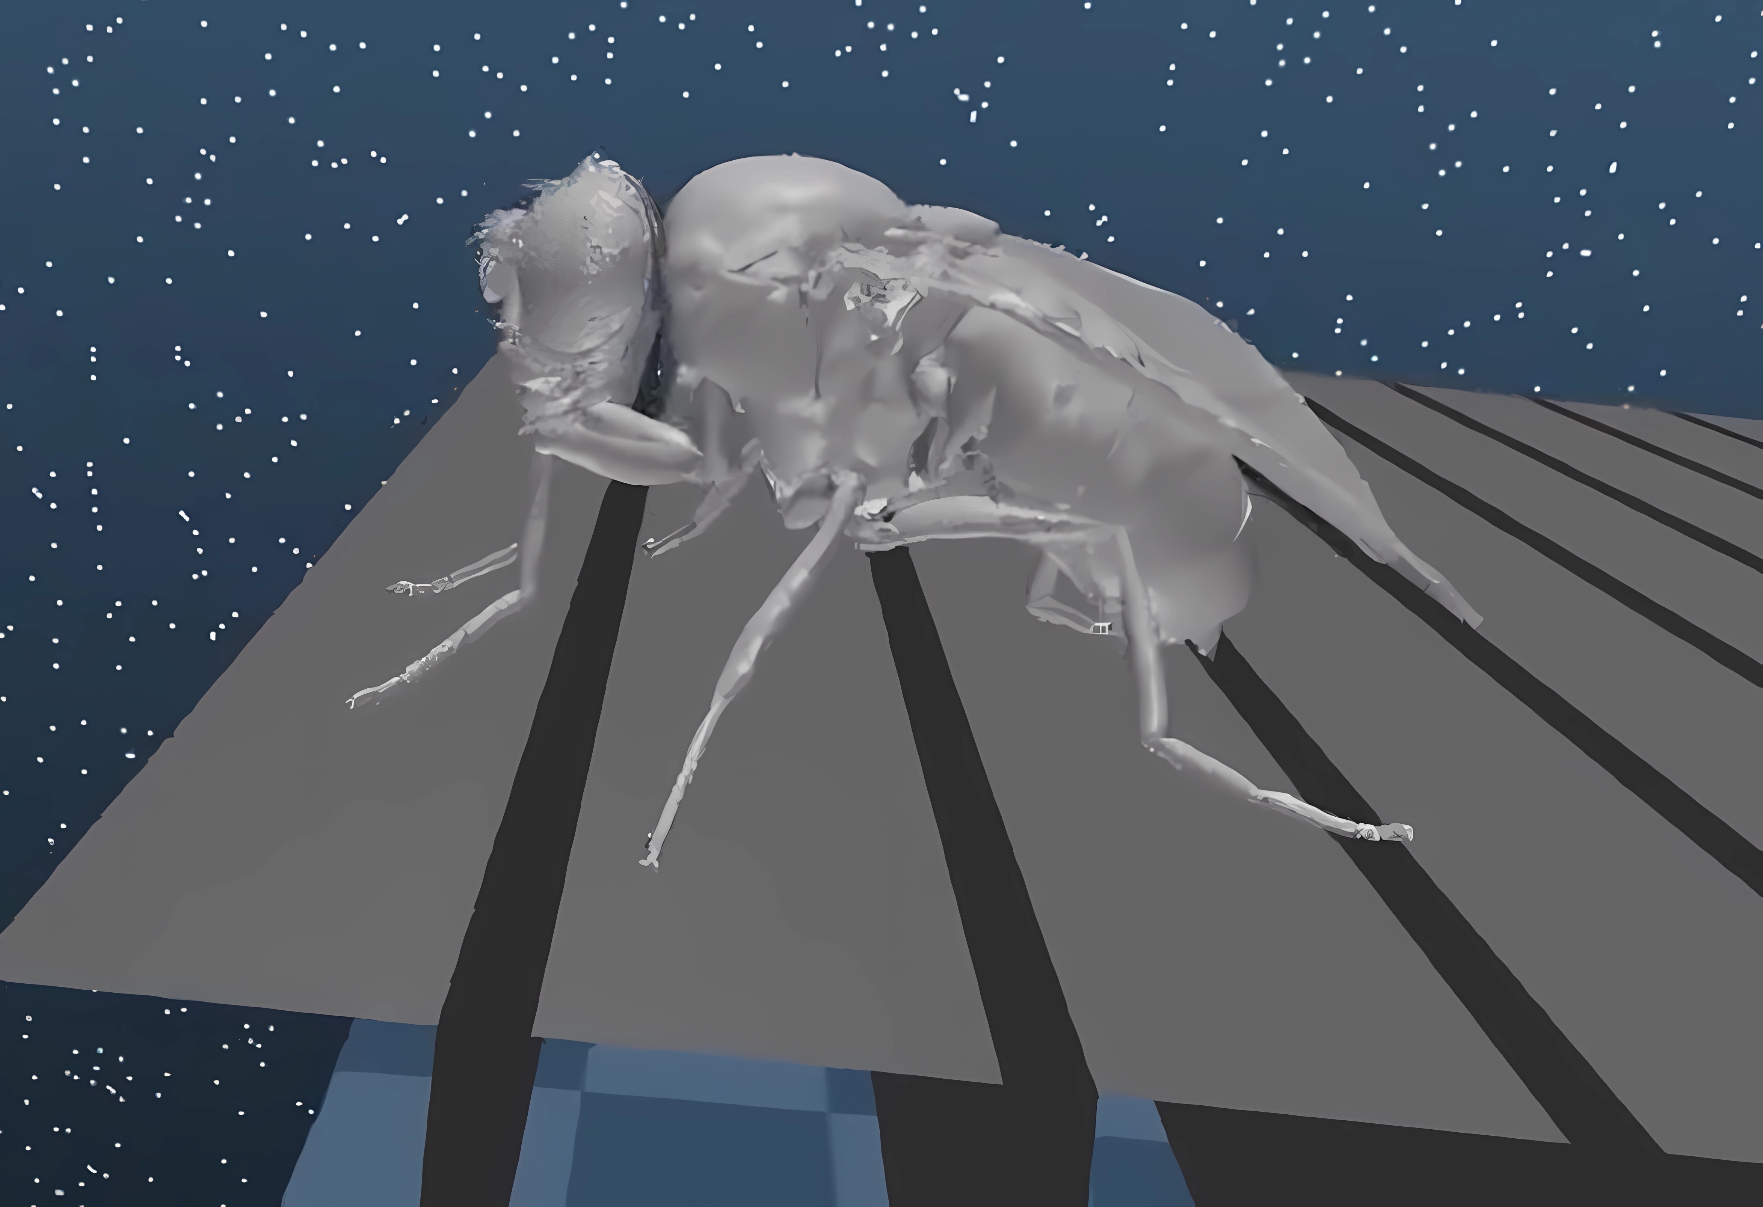
A controller for virtual fly locomotion
Alaa Abboud
Flore Munier-Jolain
Luca Zunino
COBAR
30 May 2023

Slide 2
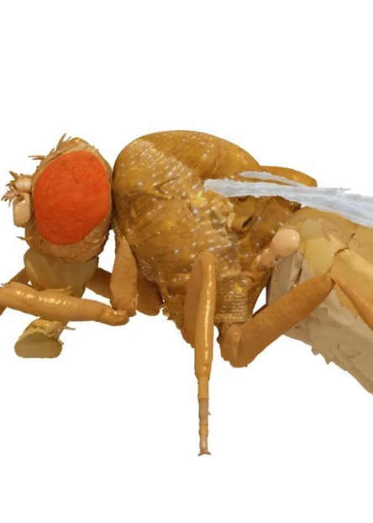
Introduction
NeuroMechFly model from Lobato-Rios et al.

Slide 3
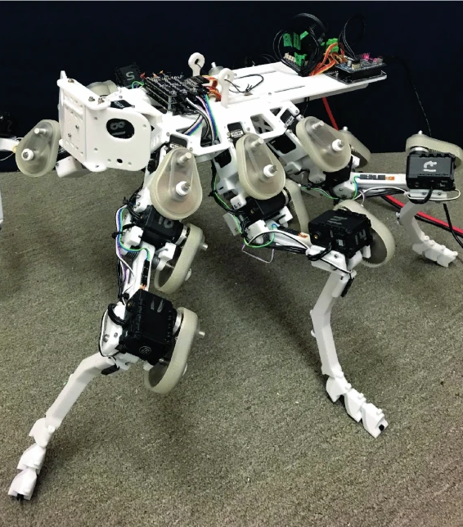
Introduction
Understanding animal behavior is crucial in fields of NEUROENGINEERING and ROBOTICS
Extract information from simulation fails
"Deconstruct" and artificially modulate behaviors
Investigate biological underlying mechanisms
Develop bio inspired robots
Drosophibot from Goldsmith et al.

Slide 4
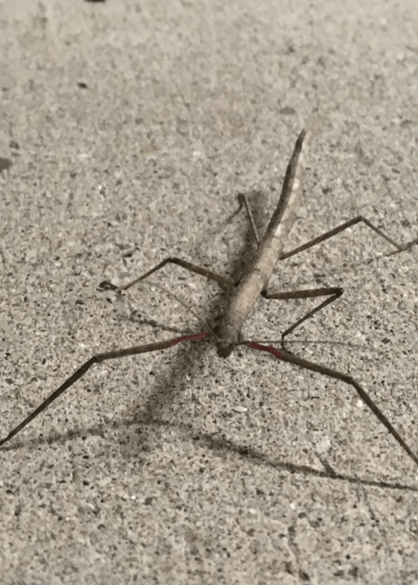
Rule-based controller
Decentralized controller based on simple rules
Results
Possible improvements
From Cruse et al.

Slide 5
Decentralized controller based on simple rules
Walking pattern controlled by rules presented in the Cruse et al.
1st rule “suppress lift-off”
2d rule “facilitate early protraction”
3rd rule “enforce late protraction”
5th rule “distribute propulsive force”
New rule: "leg gap extraction"

Slide 6
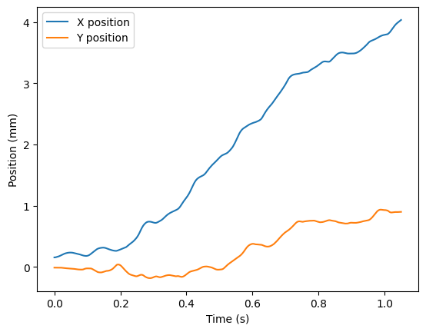
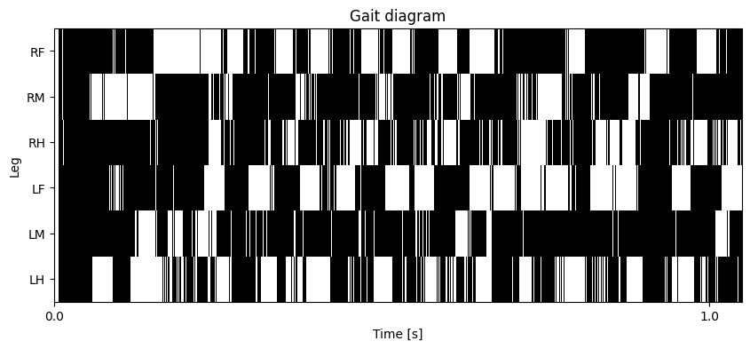
Results - Flat terrain
Forward motion
Irregular gait pattern with unbalanced swing and stance phases

Slide 7
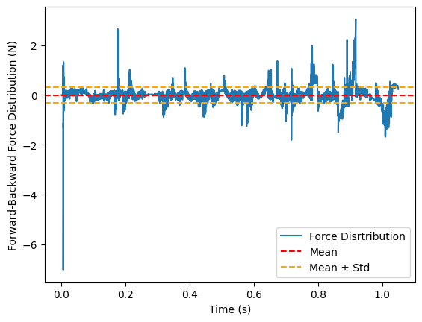
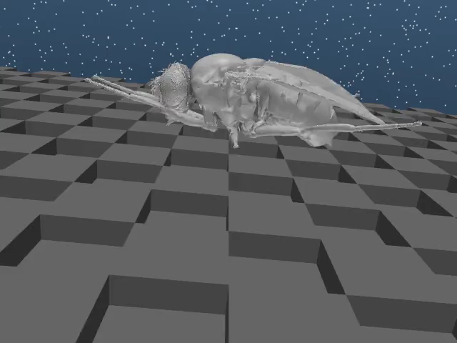
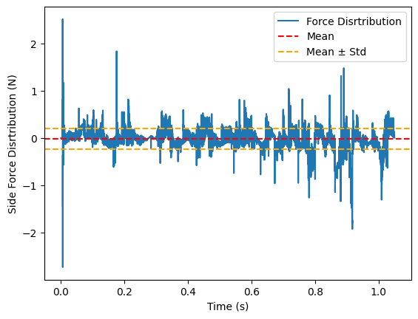
Results - Blocks terrain

Slide 8
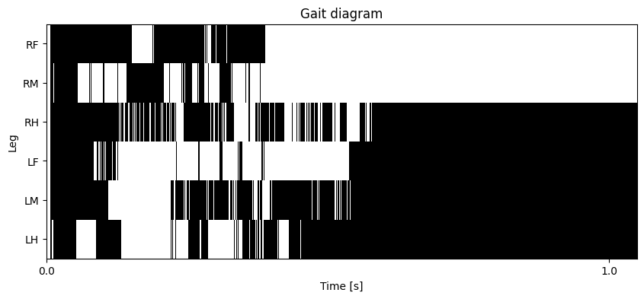
Results - Gapped terrain
Despite the additional rule the fly get stuck
Find a rules which can extract the fly when multiple legs are trapped

Slide 9
Possible improvements
Essential to tune the different rules weight with Reinforcement Learning
Implement specific swing and stance movements
Improve force signal detected by sensors
Implement new experimental rules

Slide 10
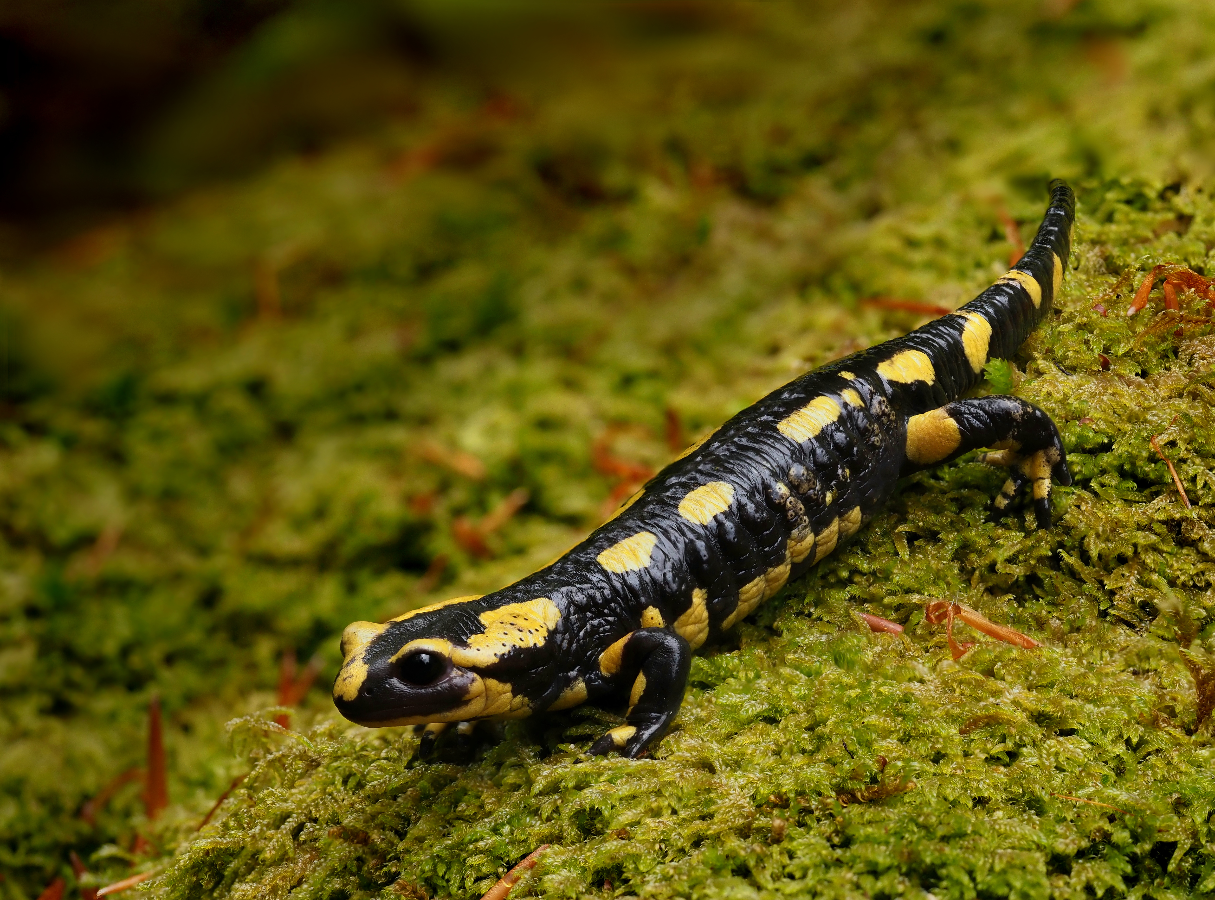
CPG-based controller
Introduction
From open-loop to closed-loop
Tripod gait VS Caterpillar gait
Results
Frank Vassen from Brussels, Belgium, CC BY 2.0 <https://creativecommons.org/licenses/by/2.0>, via Wikimedia Commons

Slide 11
Introduction
CPG-based controllers have been extensively described in literature;
One of the main limitations of the standard formulation of CPG is that it is open-loop;
CPGs are well suited for rapid, cyclical movements that do not heavily rely on sensory feedback;
We decided to employ six CPGs, one per leg.
Frank Vassen from Brussels, Belgium, CC BY 2.0 <https://creativecommons.org/licenses/by/2.0>, via Wikimedia Commons

Slide 12
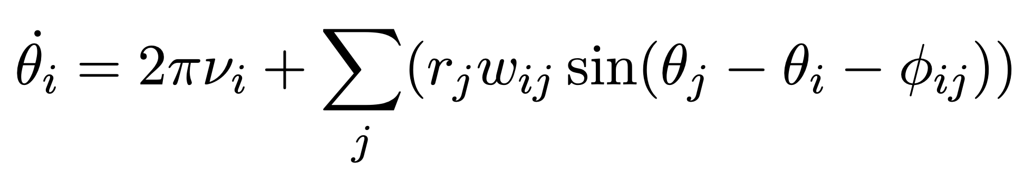
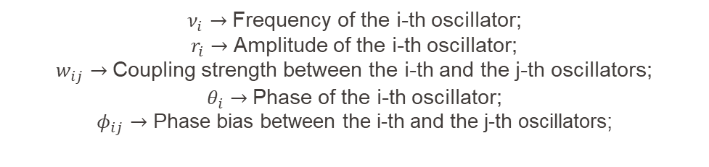
From open-loop to closed loop
CPG-based controllers have been extensively described in literature;
One of the main limitations of the standard formulation of CPG is that it is open-loop:
$ν_{i}→$ Frequency of the i-th oscillator;
$r_{i}→$ Amplitude of the i-th oscillator;
$w_{ij}→$ Coupling strength between the i-th and the j-th oscillators;
$θ_{i}→$ Phase of the i-th oscillator;
$φ_{ij}→$ Phase bias between the i-th and the j-th oscillators;

Slide 13
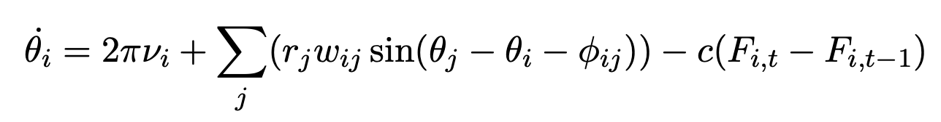
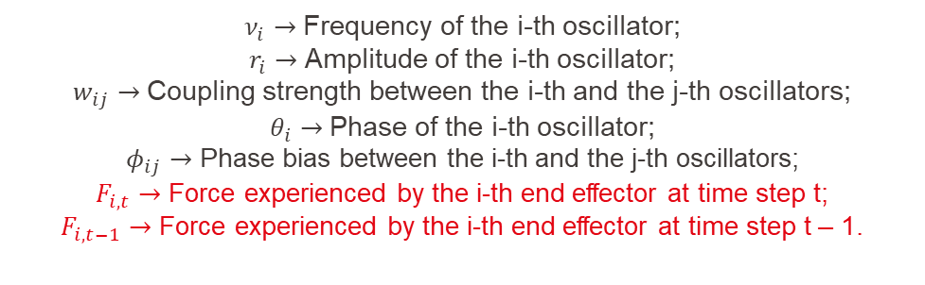
From open-loop to closed-loop
We therefore decided to introduce sensory feedback in different ways;
Strategy 1: Adding a term related to the force in the differential equation:
$ν_{i}→$ Frequency of the i-th oscillator;
$r_{i}→$ Amplitude of the i-th oscillator;
$w_{ij}→$ Coupling strength between the i-th and the j-th oscillators;
$θ_{i}→$ Phase of the i-th oscillator;
$φ_{ij}→$ Phase bias between the i-th and the j-th oscillators;
$F_{i,t}$ $→$ Force experienced by the i-th end effector at time step t;
$F_{i,t−1}$ $→$ Force experienced by the i-th end effector at time step t – 1.

Slide 14
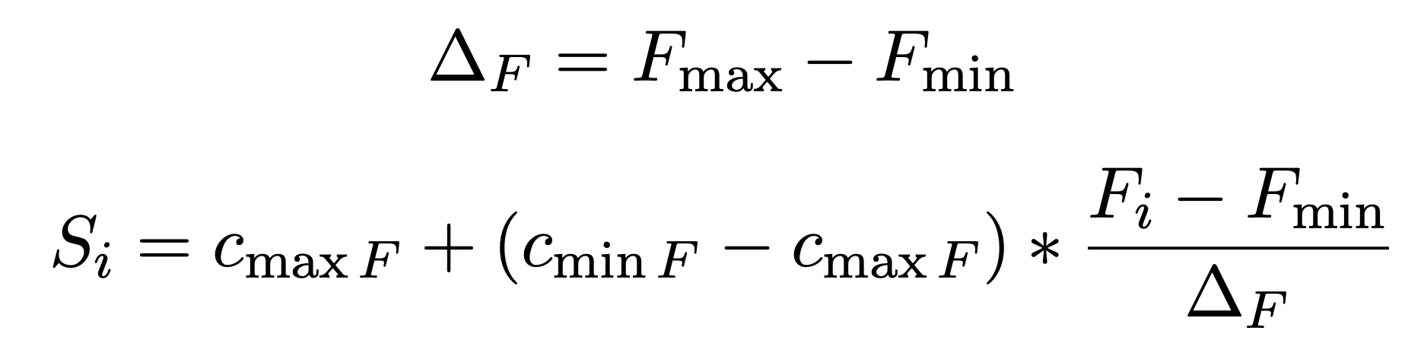
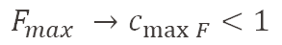
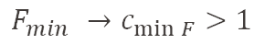
From open-loop to closed-loop
We therefore decided to introduce sensory feedback in different ways;
Strategy 2: Scaling the frequencies of the oscillators based on the contact forces experienced by the end effectors:
$$F_{max} →c_{\max{F}}<1$$
$$F_{min} →c_{\min{F}}>1$$
Linear interpolation approach

Slide 15
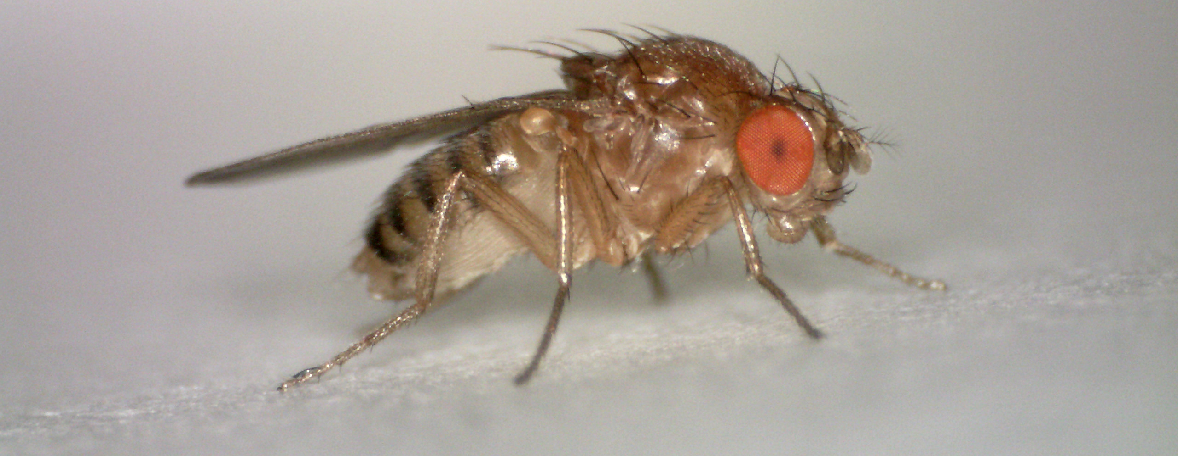
From open-loop to closed-loop
We therefore decided to introduce sensory feedback in different ways;
Strategy 3: Freezing a leg (keeping the phase and amplitude of the oscillator constant) if the experienced force is above a threshold.
Hannah Davis, CC BY-SA 4.0 <https://creativecommons.org/licenses/by-sa/4.0>, via Wikimedia Commons

Slide 16
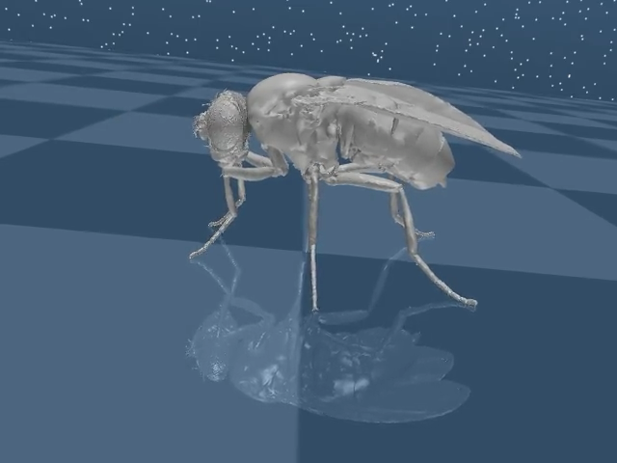
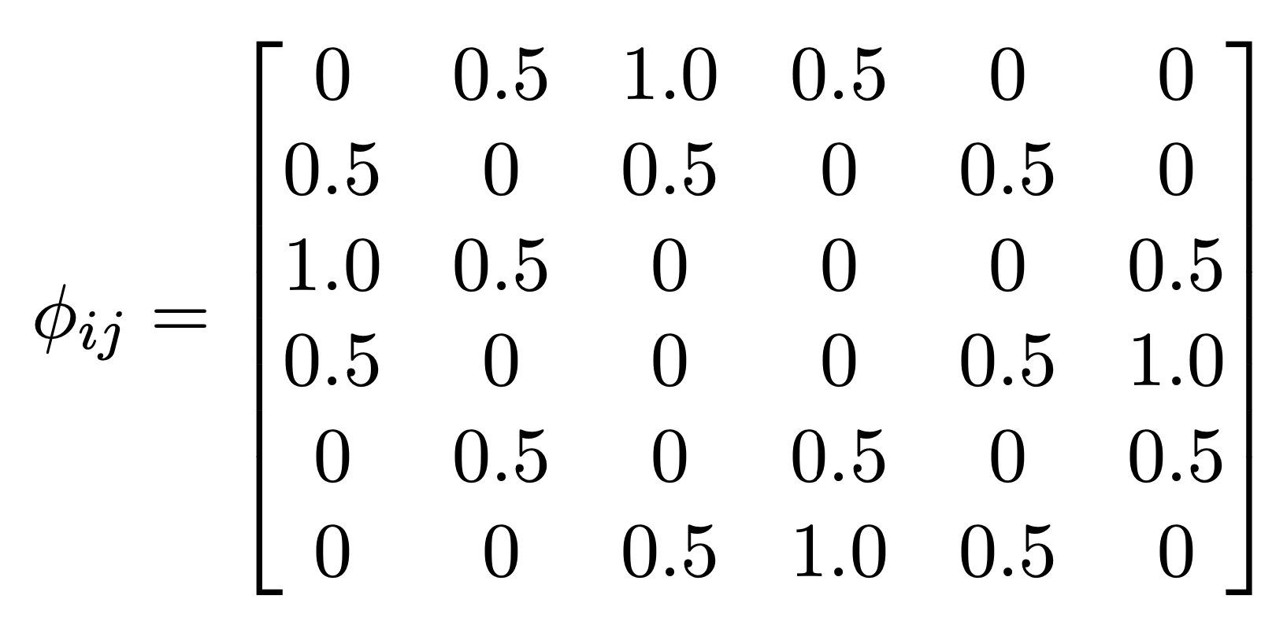
Tripod gait VS Caterpillar gait
One of the gait types described more in detail in literature is the tripod gait:
Three legs move simultaneously, the others keep contact with the ground;
Good compromise between speed and stability.
Phase bias matrix for the tripod gait

Slide 17
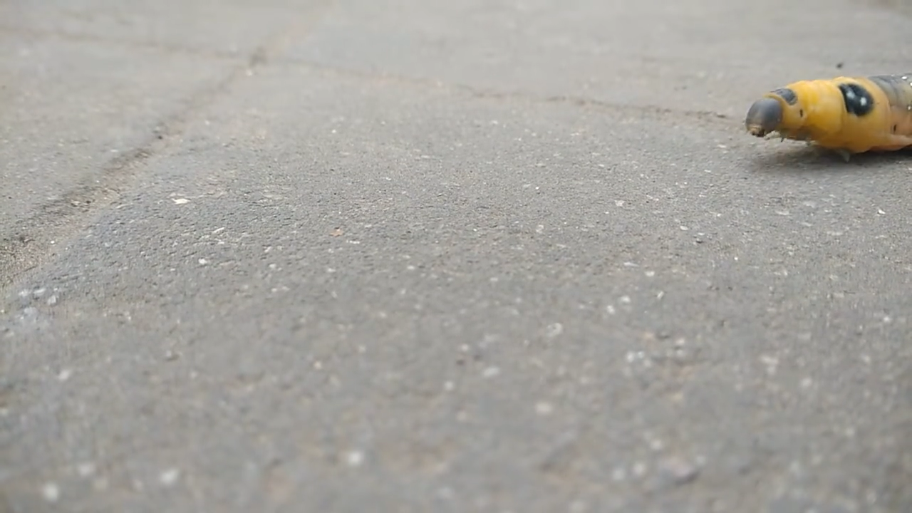
Tripod gait VS Caterpillar gait
Bodhisattwa, CC BY-SA 4.0 <https://creativecommons.org/licenses/by-sa/4.0>, via Wikimedia Commons

Slide 18
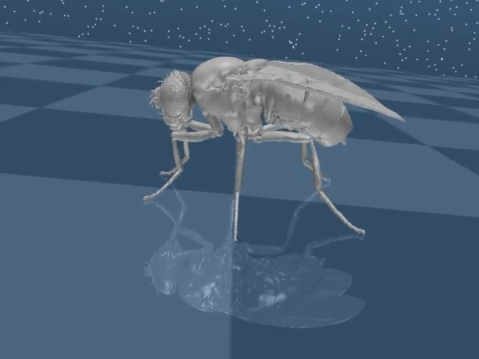
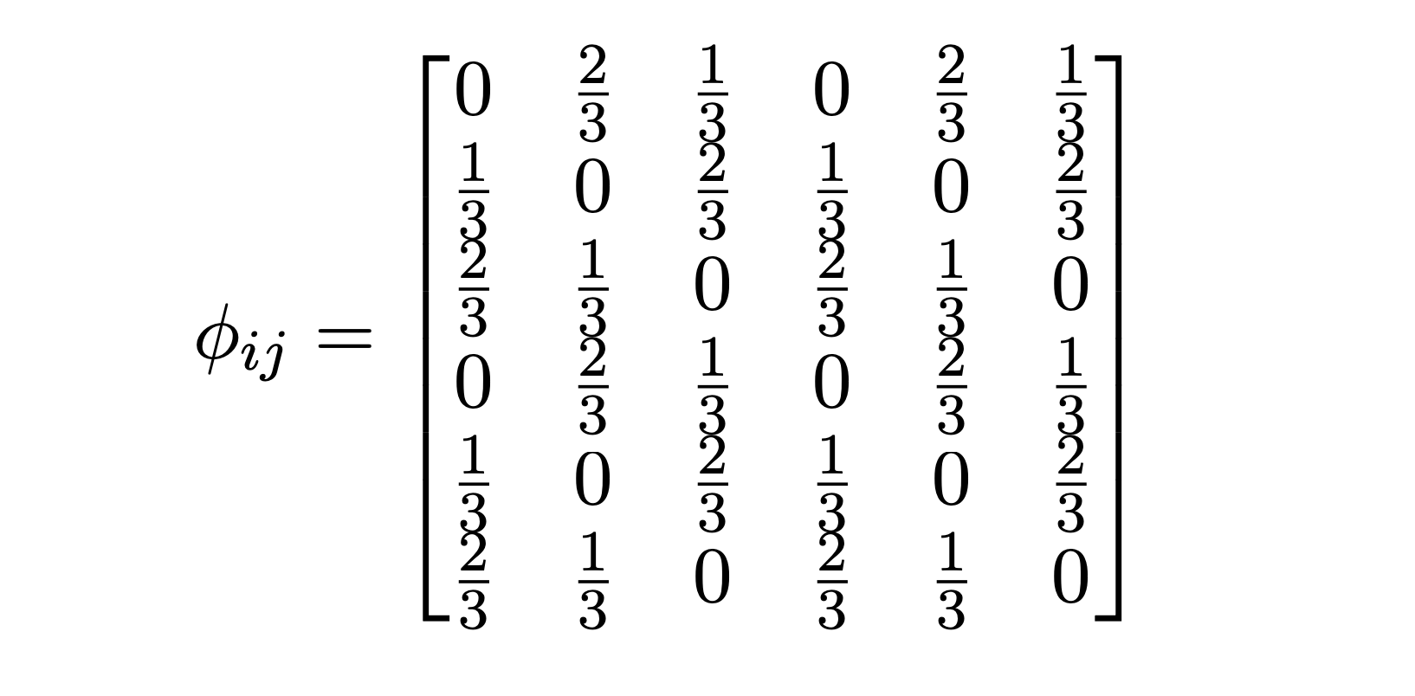
Tripod gait VS Caterpillar gait
We investigated a different type of gait, the caterpillar gait:
Wave motion, two front/mid/back legs are in the swing phase at the same time while the other four are in the stance phase;
Very stable motion without sacrificing speed.
Phase bias matrix for the caterpillar gait

Slide 19
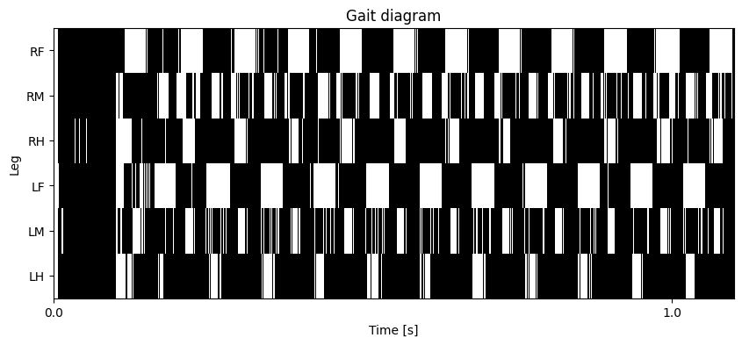
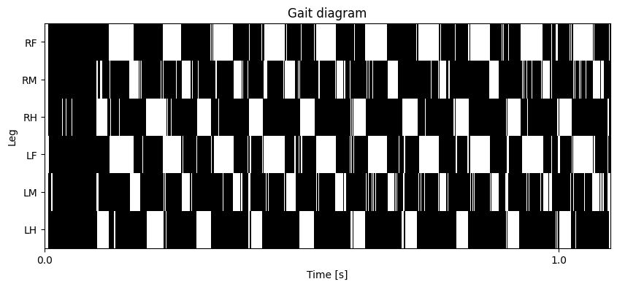
Tripod gait VS Caterpillar gait
Tripod
gait
Caterpillar
gait

Slide 20
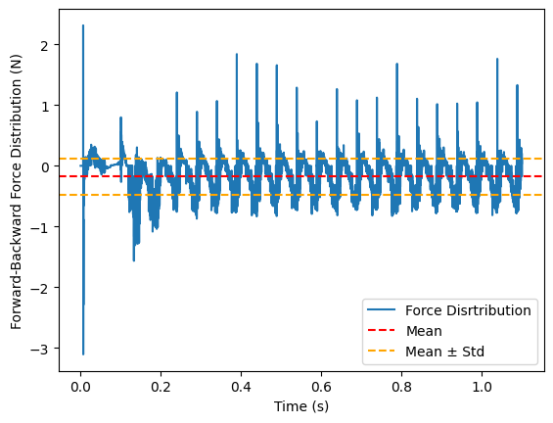
Tripod gait VS Caterpillar gait
Forward-backward force distribution for the caterpillar gait on flat terrain

Slide 21

Results – Flat terrain
The fly is quite fast and stable, the distance travelled with the caterpillar gait is larger than the one travelled with the tripod gait;
The terrain is easy to be traversed.
Terrain | Final X distance | Final Y distance
Flat | 18.65 mm | 1.71 mm
Blocks | 3.47 mm | 0.65 mm
Gapped | 4.55 mm | 0.16 mm

Slide 22
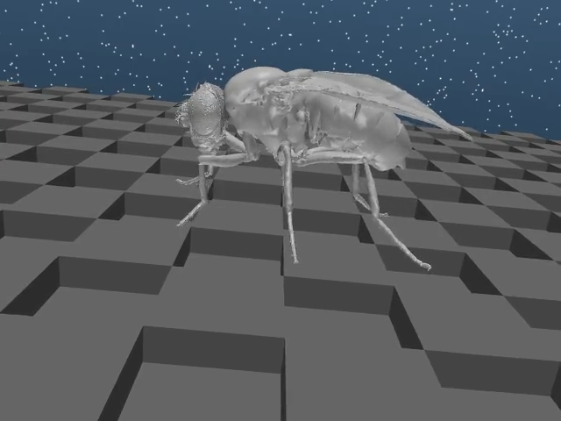
Results – Blocks terrain
The controller has trouble keeping stability in all situations, but the caterpillar gait seems to be beneficial in this regard;
Sometimes, the fly tips over.
Terrain | Final X distance | Final Y distance
Flat | 18.65 mm | 1.71 mm
Blocks | 3.47 mm | 0.65 mm
Gapped | 4.55 mm | 0.16 mm

Slide 23
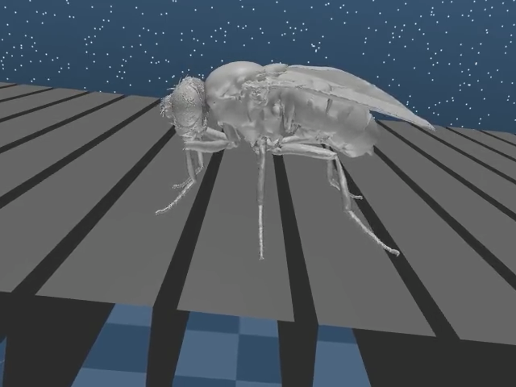
Results – Gapped terrain
The fly can free the legs from the gaps most of the time;
The caterpillar gait seems beneficial, but sometimes two legs get stuck at the same time.
Terrain | Final X distance | Final Y distance
Flat | 18.65 mm | 1.71 mm
Blocks | 3.47 mm | 0.65 mm
Gapped | 4.55 mm | 0.16 mm

Slide 24
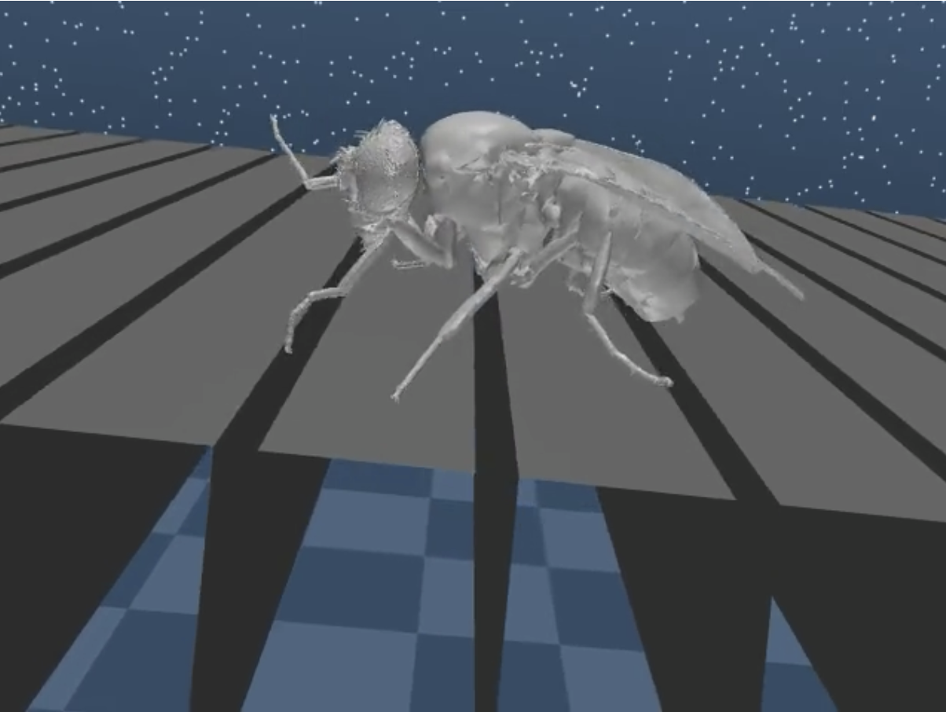
Results – Gapped terrain
The fly can free the legs from the gaps most of the time;
The caterpillar gait seems beneficial, but sometimes two legs get stuck at the same time.
Terrain | Final X distance | Final Y distance
Flat | 18.65 mm | 1.71 mm
Blocks | 3.47 mm | 0.65 mm
Gapped | 4.55 mm | 0.16 mm
Force feedback prevented tipping over

Slide 25
Rule-Based Reinforcement Learning Hybrid controller

Slide 26
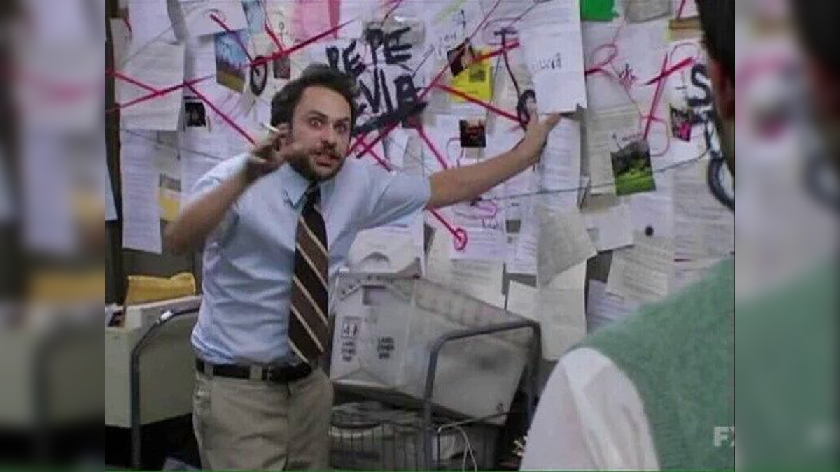
Background
The team trying to fine-tune Cruse rules.
The team trying to fine-tune CPGs.
The team trying to learn a 42-DoF continuous output using a 2-layer PPO Policy Network.

Slide 27
Background – The Capacity Problem
.
.
.
R
42
2-Layer PPO
.
.
.
Action Space
.
.
.
Joint
Angles

Slide 28
Background – Matching Capacities
R
42
Action Space
2-Layer PPO
Z
6
New Action Space
Leg
Contant Forces
Leg
Index

Slide 29
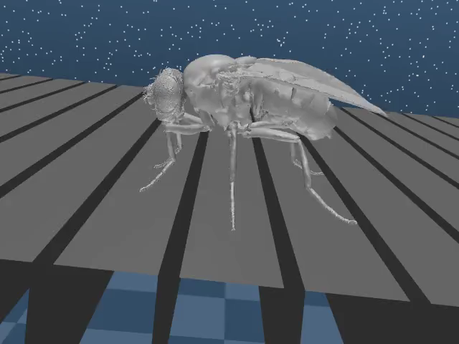
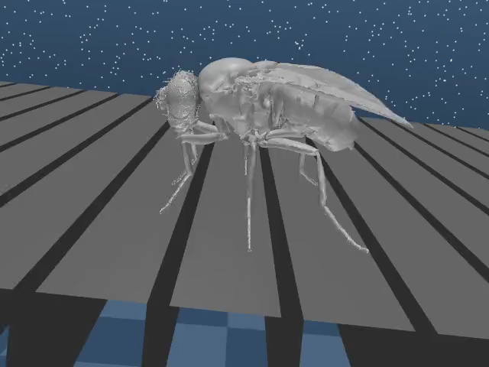
Results

Slide 30
Results
Terrain​ | Final X ​ | Final Y ​
Gapped | ~16 mm​ | -

Slide 31
Results
Terrain​ | Final X ​ | Final Y ​
Gapped | 10 mm​ | ~ -5 mm

Slide 32
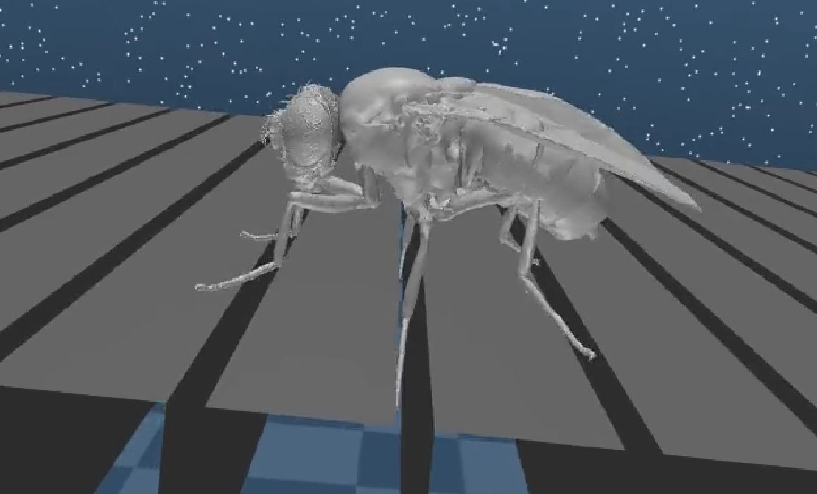
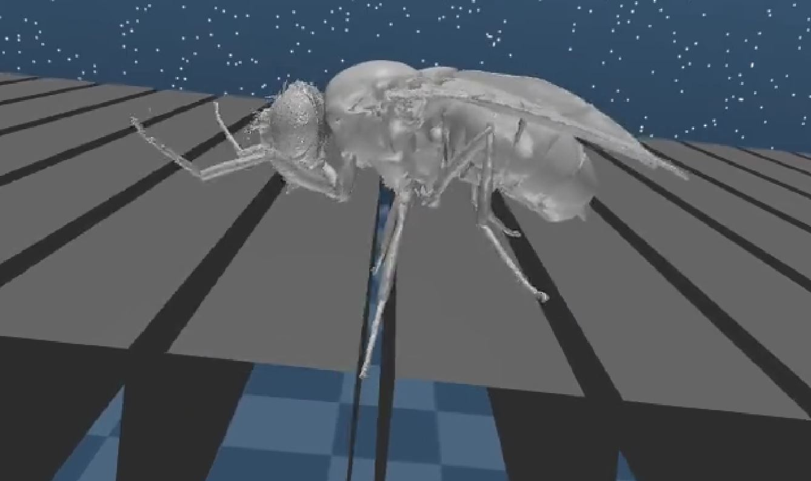
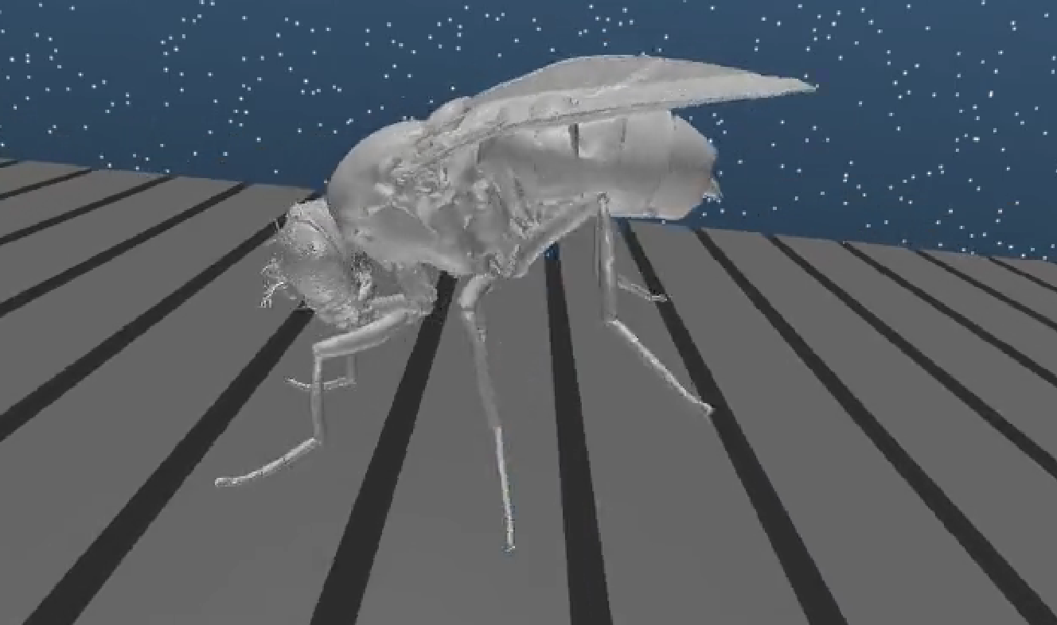
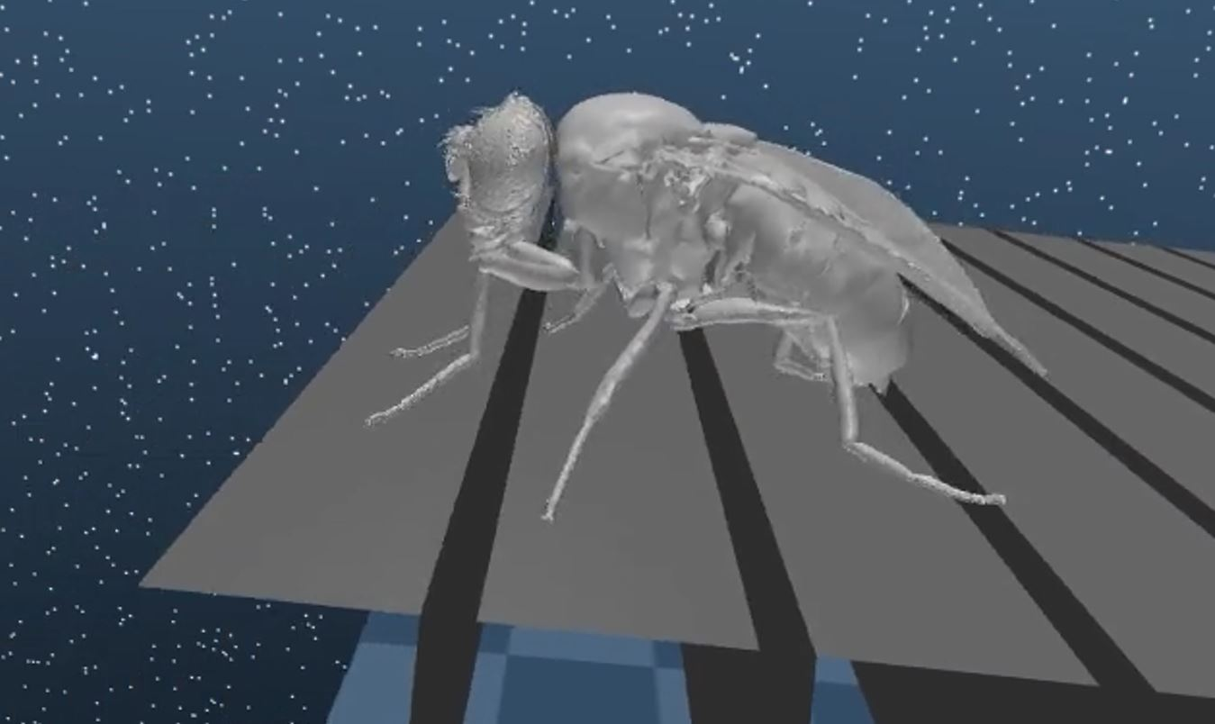
Results
1
Gets Stuck
2
Thrusts with Front Legs
3
Pulls Itself Up
4
Locomotes to the Edge of the World

Slide 33

Results
Terrain​ | Final X ​ | Final Y ​
Blocks | 7 mm​ | ~2 mm

Slide 34
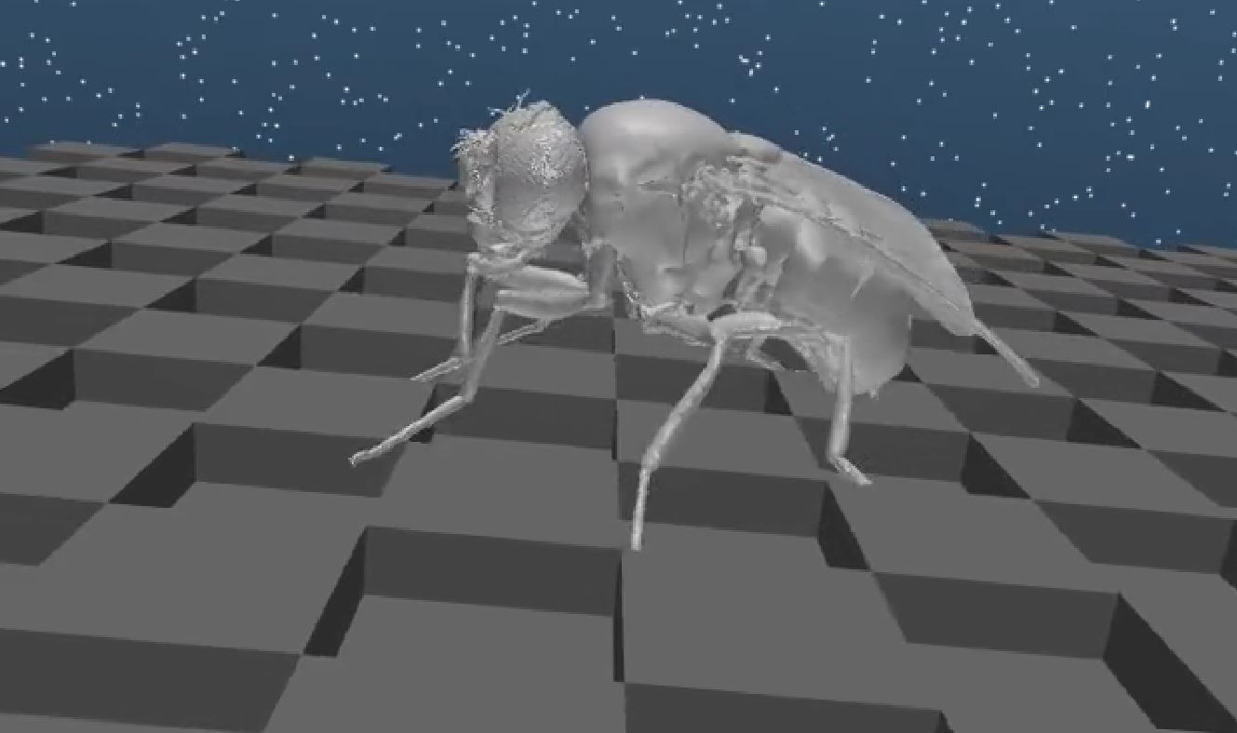
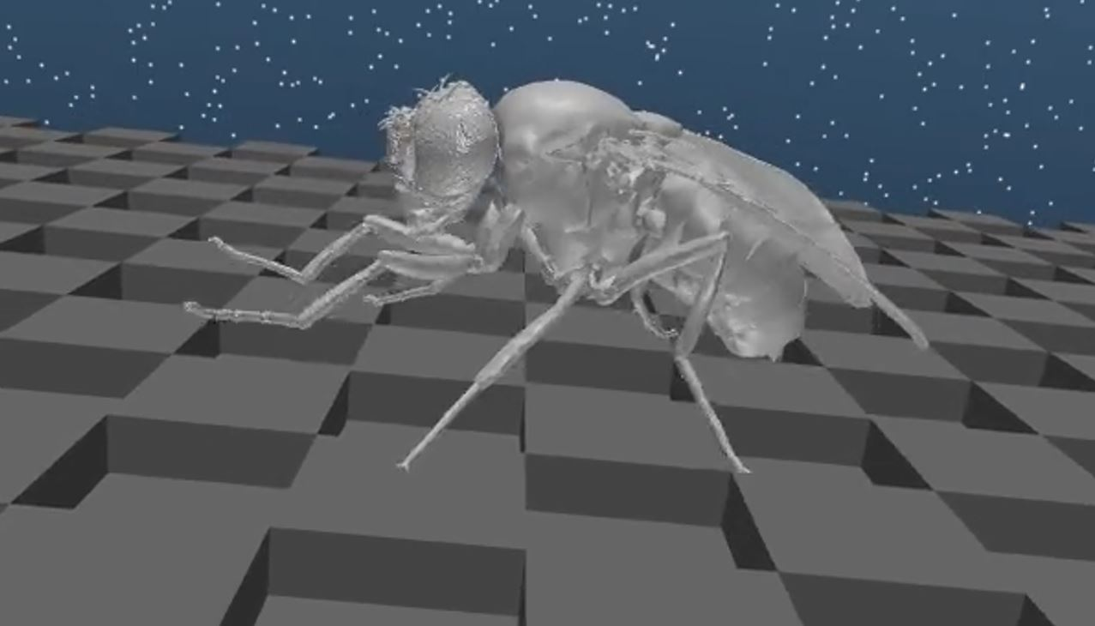
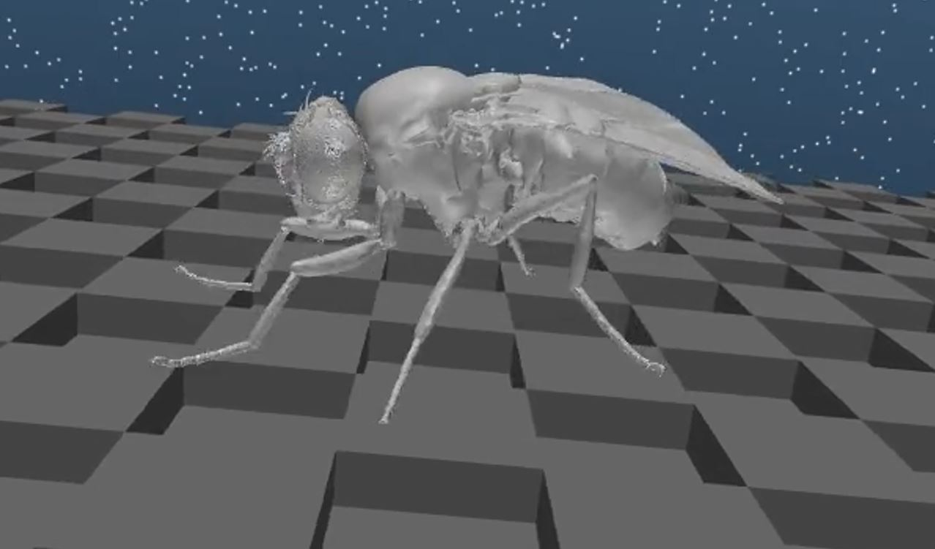
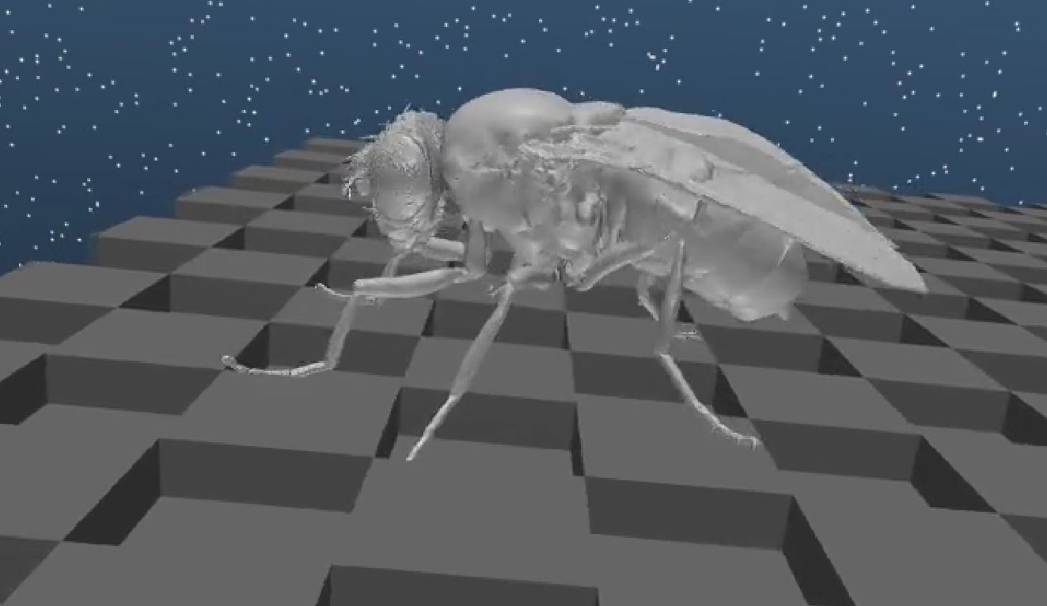
Results
Swings Front Legs – Supports with Hind Legs
1
Legs in Cavities
2
3
Pulls Itself Up
4
Good Placement

Slide 35
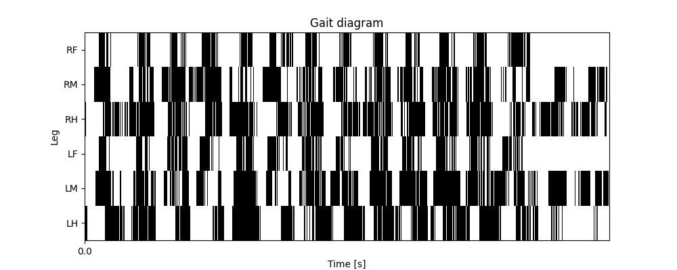
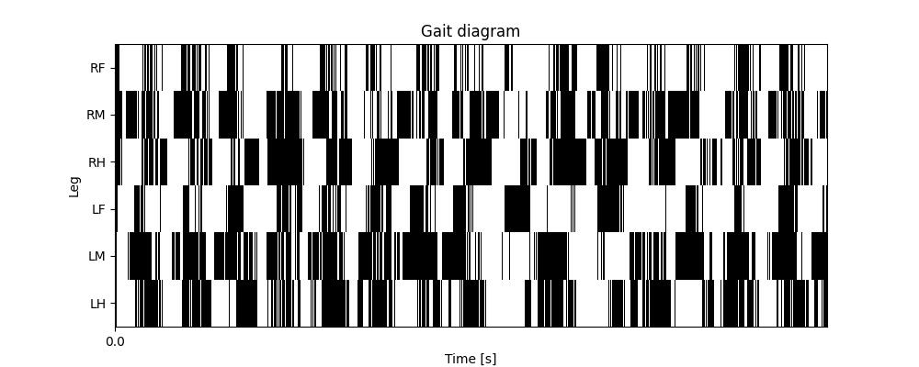
Results
LF & RF exhibit a shorter stance phase:
More reactive
Contribute less to stabilization
Contribute more to locomoting
Middle & Hind Legs exhibit a Longer stance phase:
Contribute more to stabilization

Slide 36

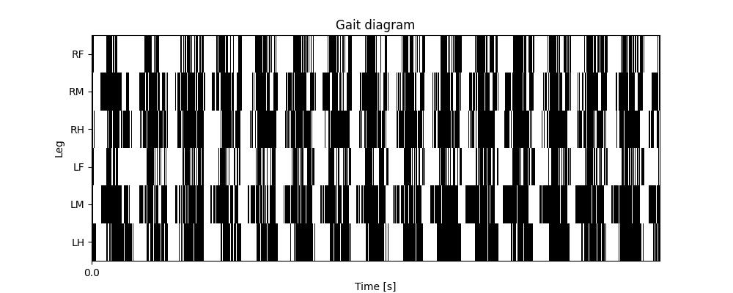
Results
Terrain​ | Final X ​ | Final Y ​
Flat | 13 mm​ | ~ 1 mm
Near-Synchronized Gait:
Hop-like locomotion

Slide 37
Summary
Summary – Rule-based controller
Summary – CPG-based controller
Summary – RL-based controller

Slide 38
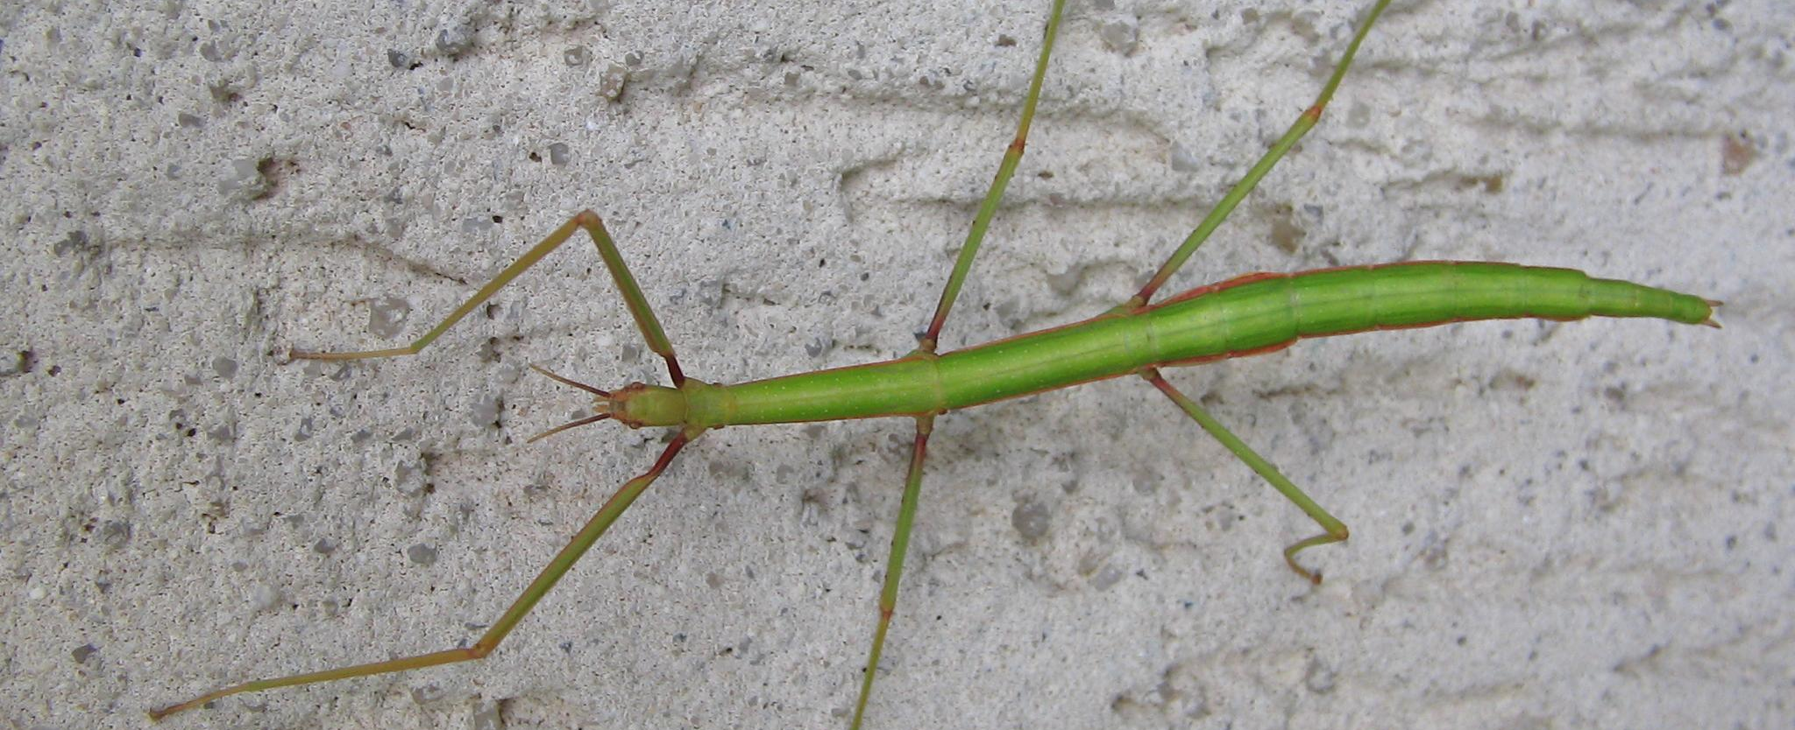
Summary – Rule-based controller
Rule-based controller shows some unsatisfactory results, but some improvements could be done to increase its robustness.
By Dэя-Бøяg - Own work, CC BY-SA 4.0, https://commons.wikimedia.org/w/index.php?curid=23119805

Slide 39
Summary – CPG-based controller
Controllers purely based on CPG are very effective on flat terrain, while sensory feedback is needed to improve performance on complex terrain;
Even with force feedback, GPG-based controllers are not entirely robust on complex terrains.
Frank Vassen from Brussels, Belgium, CC BY 2.0 <https://creativecommons.org/licenses/by/2.0>, via Wikimedia Commons

Slide 40
Summary – RL-based controller
Pure RL lacks capacity to learn a 42-DOF continuous action space;
Rule-based RL allows for a narrow action space and a more efficient optimization process, adapting well to all 3 terrains.
Hannah Davis, CC BY-SA 4.0 <https://creativecommons.org/licenses/by-sa/4.0>, via Wikimedia Commons

Slide 41
Critique

Slide 42
Critique
We were given a single dataset for the fly step, having more data could have allowed for more variability in the stepping pattern;
The mechanical model of the fly seemed quite realistic and well realized;
Integrating vision and olfaction could be valuable to realize a more robust controller.

Slide 43
Critique
These three controller could be merged:
Rule-based as a baseline simplicity
CPG-based for enhancement regularity
Reinforcement learning for fine-tuning optimization
1
2
3

Slide 44
Critique
We obtained some non-realistic gait patterns with some controllers;
Combine neurophysiological experiments with controller development to get more biologically relevant gait patterns.

Slide 45

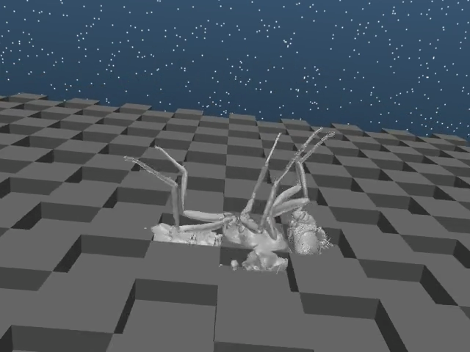
Thanks for your attention!

